Slide 1
CLOUD COMPUTING
Internet Based Services

Slide 2
What Is Cloud Computing?
Cloud Computing offers online data storage, infrastructure, and application.
Remote
Internet
Rental

Slide 3
Cloud Providers
Amazon - AWS
Microsoft - AZURE
Google - GCP
DELL
IBM
HP
ORACLE
ALIBABA

Slide 4
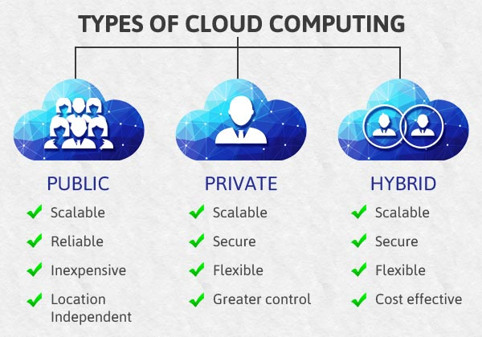
Cloud Types
Public
Private
Hybrid

Slide 5
Cloud Engineering
Server
Storage
Network
Database
Security
Application

Slide 6
Cloud Services
Infrastructure as a service (IaaS)
Server
Storage
Network
Platform as a service (PaaS)
Database
Security
Software as a service (SaaS)
Application

Slide 7
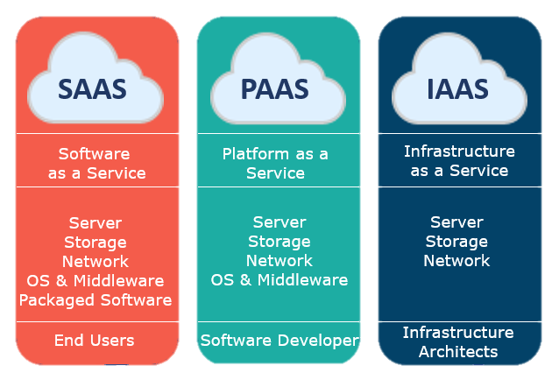

Slide 8
THANK YOU

